Slide 1
Health-care analytics

Slide 2
Agenda
1. Inner Join
2. Left Join with Null Handling
3. Right Join & Aggregation
4. Full Join
5. Windows Function
6. Conditional Expressions
7. Numeric & String Functions
8. Subqueries
9. Date & Time Function
10. Complex Join & Aggregation

Slide 3

Task - 1

Slide 4

EXPLANATION:
This query joins the appointments,patients,and doctors table.
And retrieve only the appointments that are marked as completed.

Slide 5
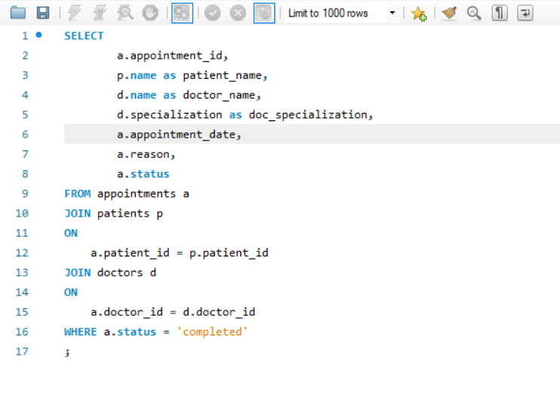
Inner-join

Slide 6
Task - 2

Slide 7

EXPLANATION:
Here identifies patients who have never scheduled
or attended any appointment by using left join.
And Filtering Null values from the appointment
table.

Slide 8
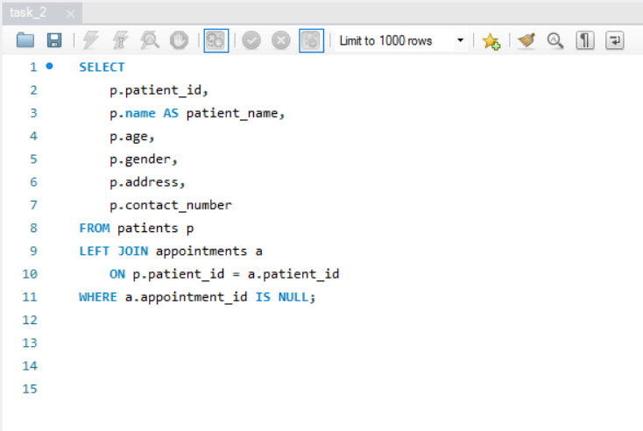
left-join

Slide 9
Task - 3

Slide 10
EXPLANATION:
I used a right join to count the number of
diagnoses associated with each doctor.
And I included the doctor name,specialization and
total diagnoses

Slide 11
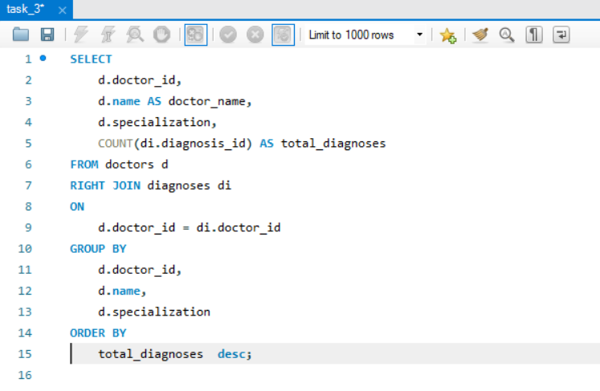
RIGHT-join

Slide 12
Task - 4

Slide 13
EXPLANATION:
Here I used a union to achieve a full join
It’s help identify the records present in one table
but missing in the other.

Slide 14
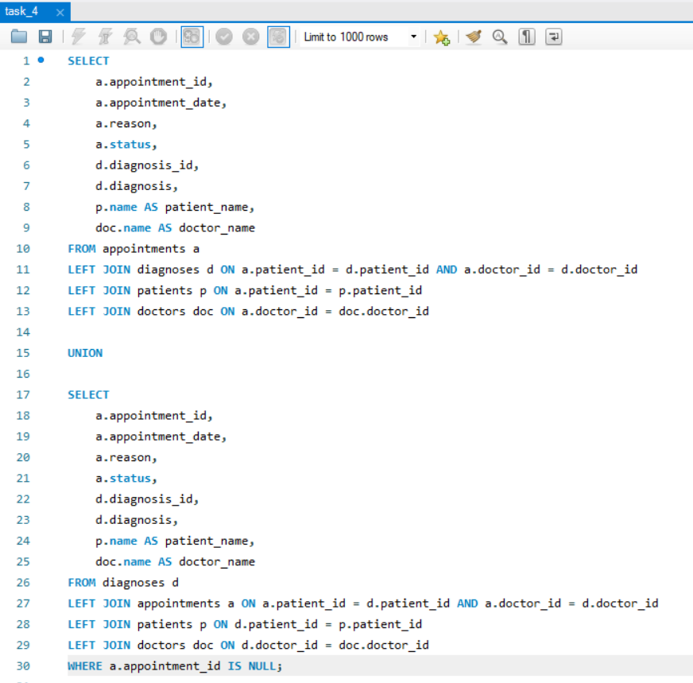
full-join

Slide 15
Task - 5

Slide 16
EXPLANATION:
Here I used a Dense_rank() to rank patients based
on how frequently they met a doctor.
Helping doctor to identify frequent visitors.
In second query we can see the total patients
attend by the doctor.

Slide 17
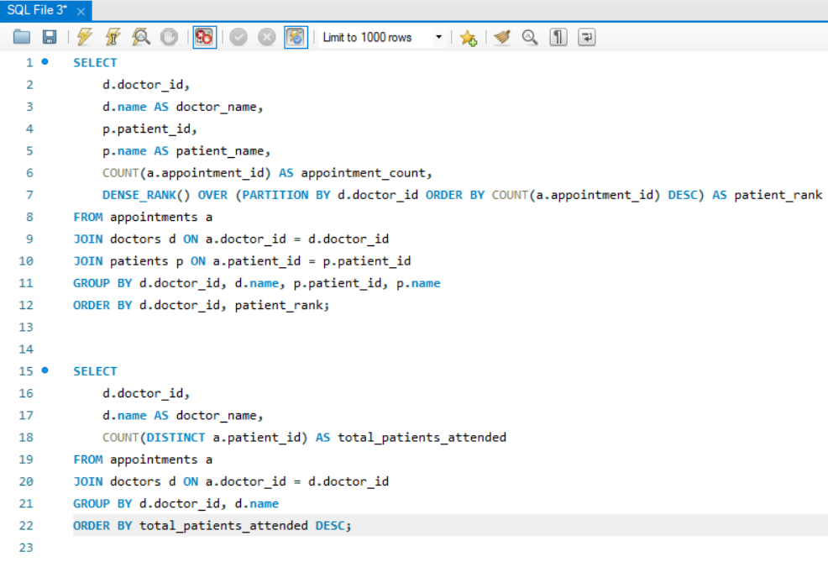
WINDOWS - FUNCTION

Slide 18
Task - 6

Slide 19
EXPLANATION:
This query classifies patients into four age groups:
MINOR (age < 18)
YOUNG (age 18–30)
YOUNG OLD (age 31–50)
GETTING OLD (age > 50)
Then I used a count() function to calculate the total number.

Slide 20
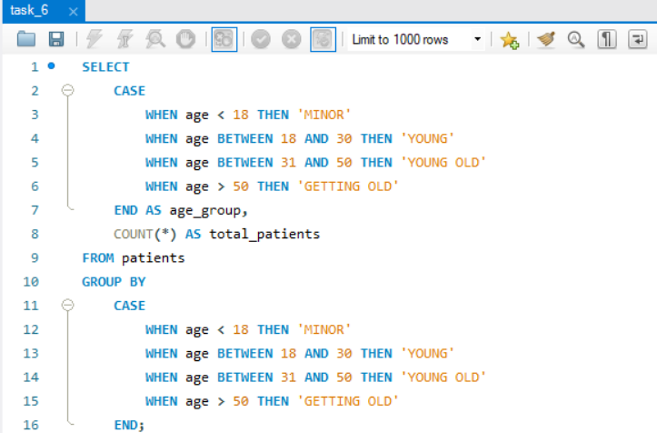
Conditional - expressions

Slide 21
Task - 7

Slide 22
EXPLANATION:
Converts the patient's name to uppercase.
Filters patients whose contact numbers end with
"1234".

Slide 23
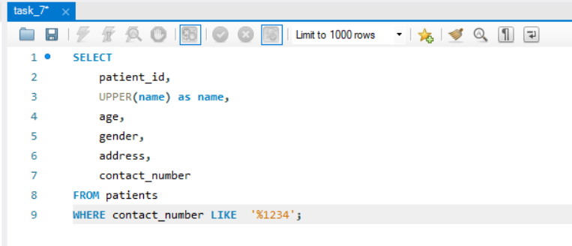
Numeric & string function

Slide 24
Task - 8

Slide 25
EXPLANATION:
Finding the patients who were prescribed only
Insulin.
Here I used subqueries for filtering.
Joining the patients, diagnoses, and medications
tables.
Filtering the patients whose only prescribed
medication is "Insulin“ using subquery.

Slide 26
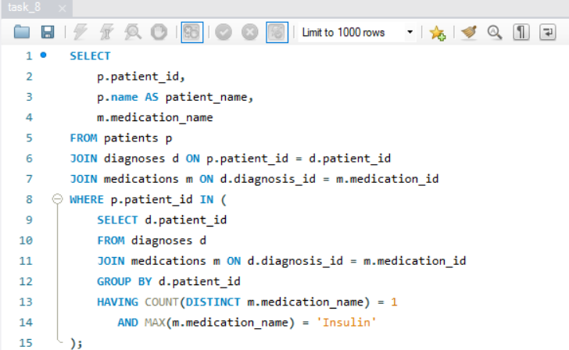
SUBQUERIES

Slide 27
Task - 9

Slide 28
EXPLANATION:
Calculating the average number of days a
medication was prescribed for each diagnosis.
It helped to identify how long different medications are prescribed for specific diagnoses.
Here I used a DATEDIFF() function to get a duration in days.

Slide 29
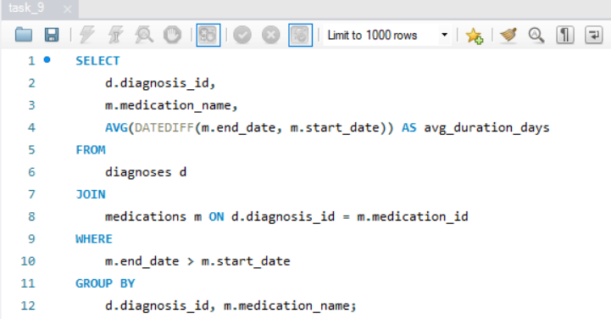
Date & time function

Slide 30
Task - 10

Slide 31
EXPLANATION:
In this task I Identify the doctor who has attended
the highest number of unique patients by using
count(distinct) function.
Then I added a doctor name and their
specialization and their unique count also.

Slide 32
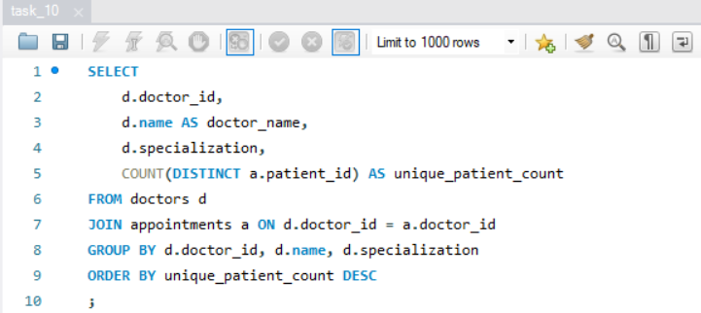
Complex joins & aggregation

Slide 33
Top 10 doctors​
Doctor ID | Doctor Name | Specialization | Patient count
37 | Doctor_37 | General Medicine | 51
225 | Doctor_225 | Orthopedics | 49
209 | Doctor_209 | General Medicine | 47
300 | Doctor_300 | Orthopedics | 47
35 | Doctor_35 | Neurology | 46
17 | Doctor_17 | Pediatrics | 46
12 | Doctor_12 | Pediatrics | 45
143 | Doctor_143 | Pediatrics | 45
13 | Doctor_13 | Orthopedics | 44
16 | Doctor_16 | Pediatrics | 44
From this task this are the top 10
doctors who perform actively.

Slide 34
Top 10 patients​
Patient ID | Patient Name | Patient Age | Total Visits
4319 | Patient_4319 | 73 | 8
950 | Patient_950 | 88 | 8
1422 | Patient_1422 | 70 | 8
762 | Patient_762 | 25 | 8
4926 | Patient_4926 | 55 | 8
3349 | Patient_3349 | 26 | 7
2416 | Patient_2416 | 18 | 7
111 | Patient_111 | 59 | 7
949 | Patient_949 | 42 | 7
2447 | Patient_2447 | 45 | 7
From this task this are the top 10
patients who visit actively.

Slide 35
Total cases​
Diagnosis | Total cases
Migraine | 3050
Flu | 3019
Fracture | 3004
Diabetes | 2973
Hypertension | 2954

Slide 36
THANK YOU

